Slide 1

AIR BNB CASE STUDY PPT 2
By: Pallavi Bothra
Priyanka Swain
Pritam Panchal
(DSC-58)

Slide 2
Context
Problem Statement
End Objective
Insights
Recommendations
Methodology

Slide 3

Problem Statement
Airbnb, Inc. is a leading American corporation facilitating an online platform connecting travellers with diverse lodging options, including homestays for vacation rentals, and a range of tourism experiences.
Airbnb has seen a major decline in revenue. Now that the restrictions have started lifting and people have started to travel more. Airbnb wants to make sure that it is fully prepared for this change.

Slide 4
End Objective
To strategize post-COVID-19 landscape and comprehensively understand current customer sentiments and desires.
Develop a robust long-term business strategy that aligns with evolving customer expectations & revenue optimization.

Slide 5

Insights

Slide 6
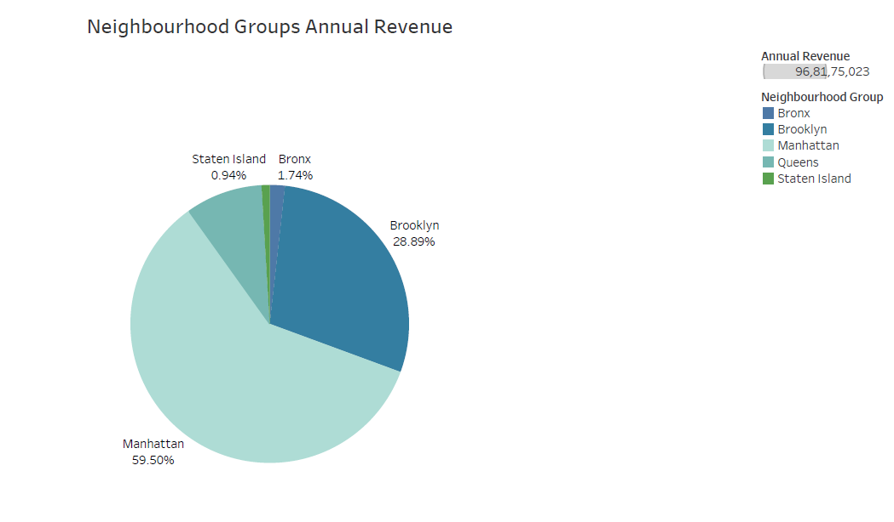
Top Neighbourhood Groups based on Annual Revenue
Manhattan & Brooklyn hold the maximum share of revenue among all the neighbourhood groups.

Slide 7
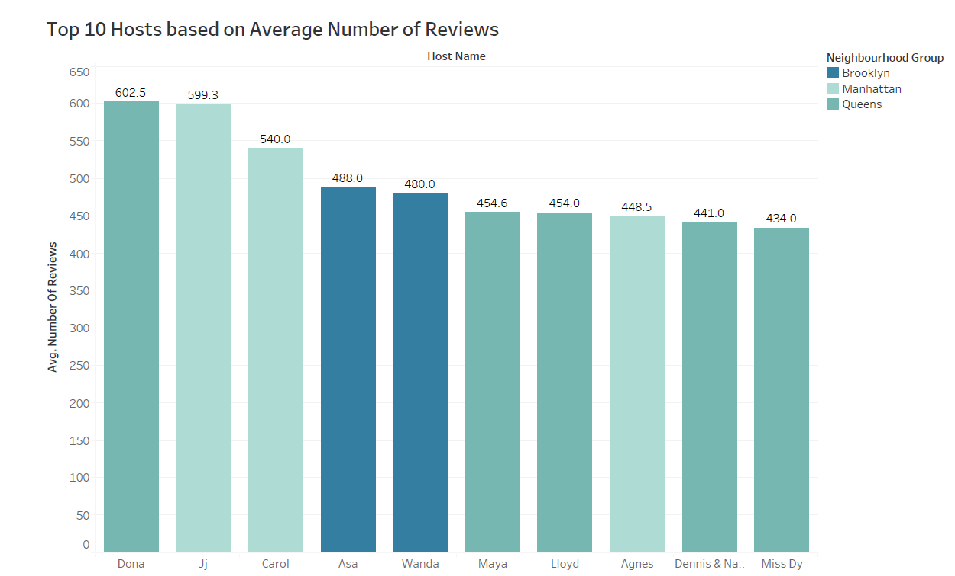
Dona from Queens & Jj & Carol from Manhattan are the top 3 hosts based on reviews.
Queens have the highest monthly reviews followed by Manhattan.
Experiences of these top hosts should be examined which can be implemented by other hosts to get them more attractive.

Slide 8
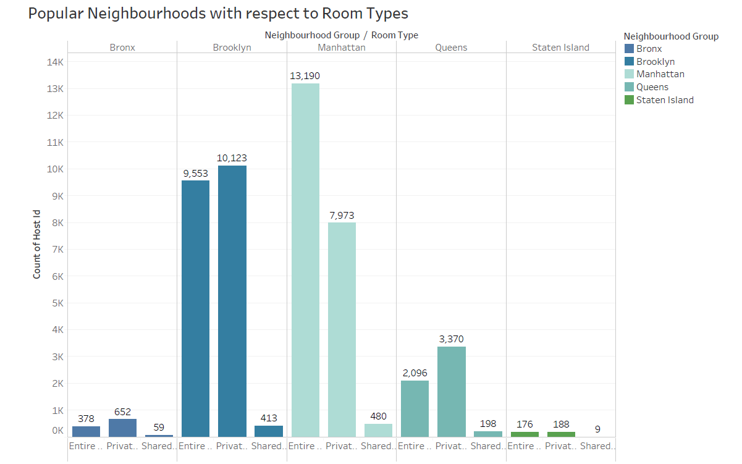
Manhattan & Brooklyn are very popular across all room types.

Slide 9
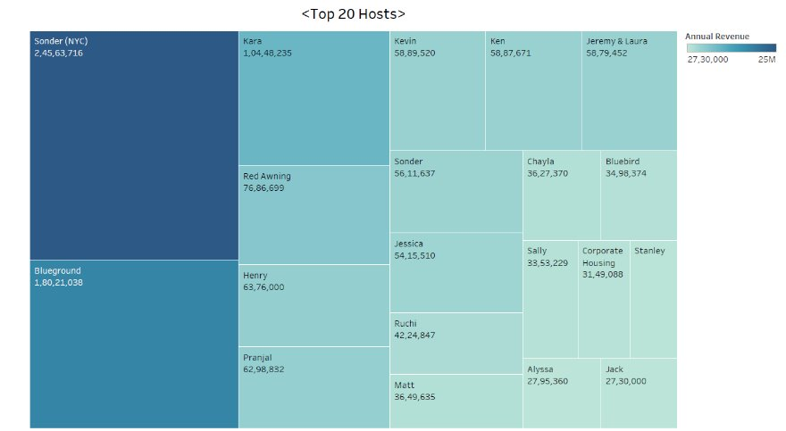
Top 20 Hosts based on Annual Revenue
Sonder NYC & Blueground are the top hosts followed by Kara among all the neighborhood groups.
There is more scope to grow in these Regions as they have the highest annual revenue.

Slide 10
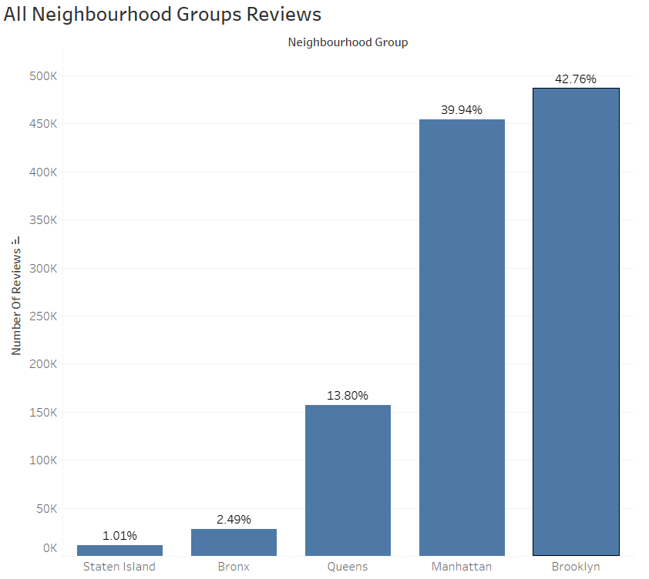
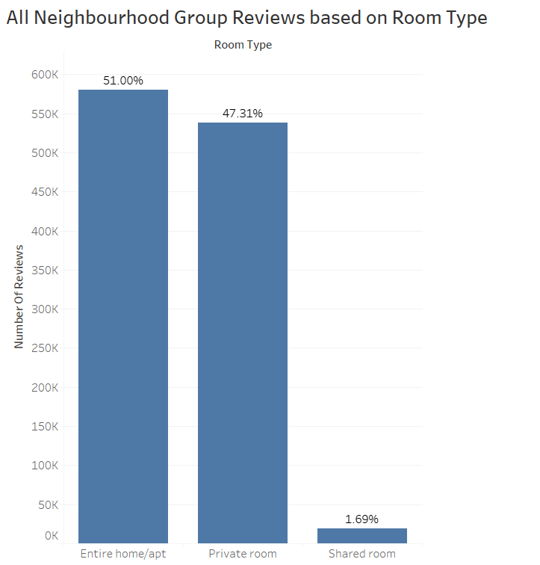
Manhattan and Brooklyn have the highest group reviews.
Most of the reviews are for Entire home/apt and Private rooms.

Slide 11
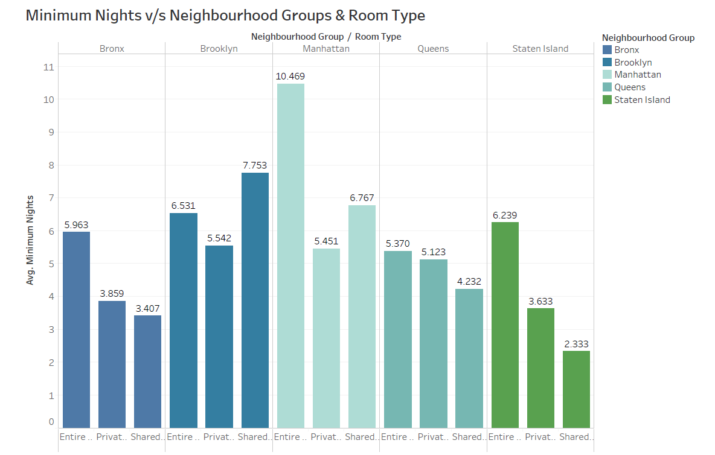
Minimum Nights spent are highest for Manhattan in Entire Home/apt followed by Shared Rooms.
In Brooklyn Shared Rooms have the highest minimum nights.

Slide 12

Recommendations
Manhattan & Brooklyn are the top neighbourhood groups generating highest revenue and top reviews, but the average prices could be planted more competitively.
Provide discounts on increasing the minimum night's stay to increase customer engagement.
Entire Home/Apt & Private Rooms have high number of reviews, but the minimum night's stay are more for shared rooms. We can see that customers are inclined towards shared rooms for longer stay, this segment should be targeted and promoted.
The experiences of the top hosts could be examined & can be implemented by others hosts as well to gain more footfall and better customer experience.

Slide 13
Methodology
Data Cleaning in Excel (Handling Missing Values & Data Types)
Data Visualization & Analysis in Tableau (on Price, Room Type, Neighbourhood and Neighbourhood Groups, Hosts, Minimum Nights, etc)

